Slide 1
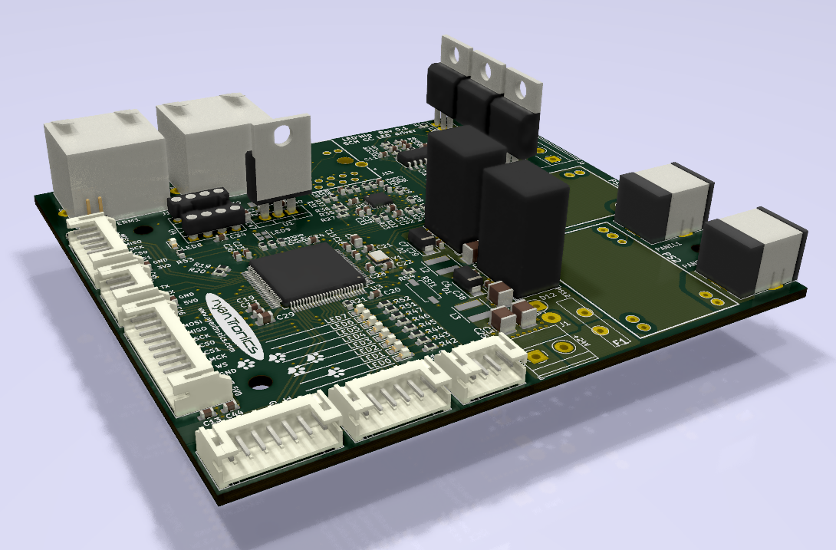
LEDNip 0.1 - 5 channel LED driver board
2018-11-05

Slide 2
What?
driver board for indoor LED lighting
2-channel 1A CC drivers for 8-24V LED chains (CUI barrel jacks for panels)
3-channel 1A CC drivers for RGB strips (linear / PWM)
control via UART, CAN, Ethernet
lots of peripherals for extensions and building automation
compact 9x10cm 4-layer PCB for best performance
Open source hardware project
multiple maintainers
KiCAD project files
open source firmware
BOM cost: 45-55€

Slide 3
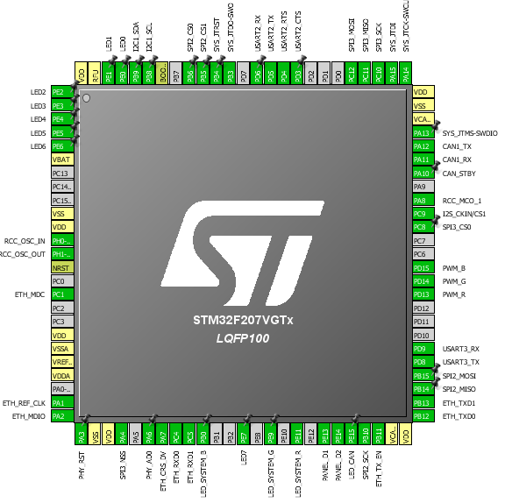
Features:
STM32F427 Cortex-M4 microcontroller
24V input for use with common power supplies (cost-effective fan-less MeanWell 100W)
2x 0..1000 mA CC LED driver
up to 97% efficiency
industry-proven potted module 2000Khrs min. MIL-HDBK-217F
PWM dimming (spec: < 1kHz, tested up to 7 kHz)
12V / 3.3V buck converter modules
multi-sourced potted modules from reputable manufacturers (RECOM, Gap-Tec)
on-board 3-channel current controller for RGB strips
10/100 Ethernet
CAN bus + daisychaining JR45 (CAT5)
JTAG/SWD
lots of interfaces for whatever comes our way
2x UART/USART w/ flow control
2x SPI (option for I2S)
I2C
secondary CAN

Slide 4
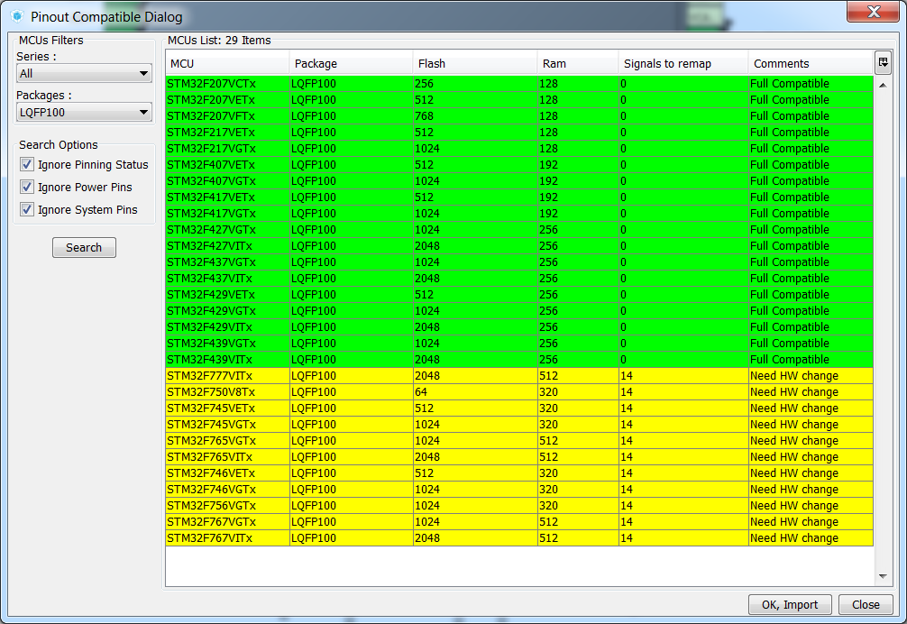
multiple controller options:
can be adjusted to applications
less problems sourcing
Design tool CubeMX
Cortex-M3 / Cortex-M4 options

Slide 5
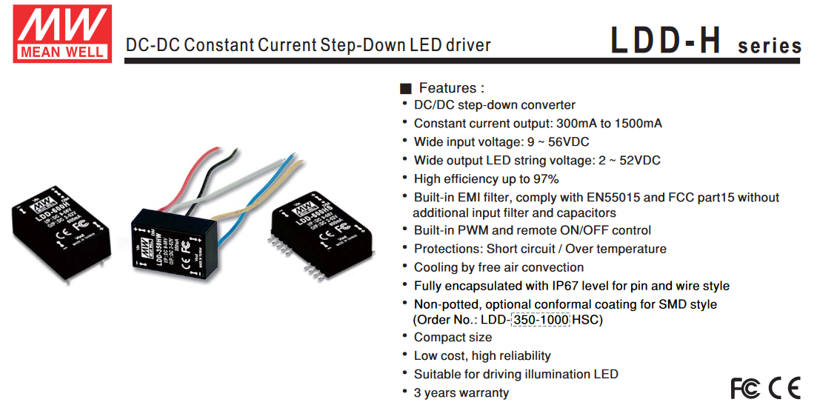

Slide 6
Status?
[done] Schematic design (~30h)
[done] Schematic review (2 reviewers) (~5h)
[done] Layout (~70h)
[done] Layout validation (3 reviewers) (~5h)
[done] parts availablilty check – mostly sourced from Mouser
[ongoing] parts attributes in KiCAD and BOM export
[done] experimental validation MeanWell LDD-1000H
[done] experimental validation 1A linear CC sinks
[pending] prototyping strategy (5+25 boards vs. 30+ boards at once, w/ stencil)
[pending] parts sourcing (mission critical parts stocked)
[ongoing] PCB assembly capabilities (professional P&P + reflow options, manual)
[pending] prototype evaluation w/ PCBs
[ongoing] firmware development

Slide 7
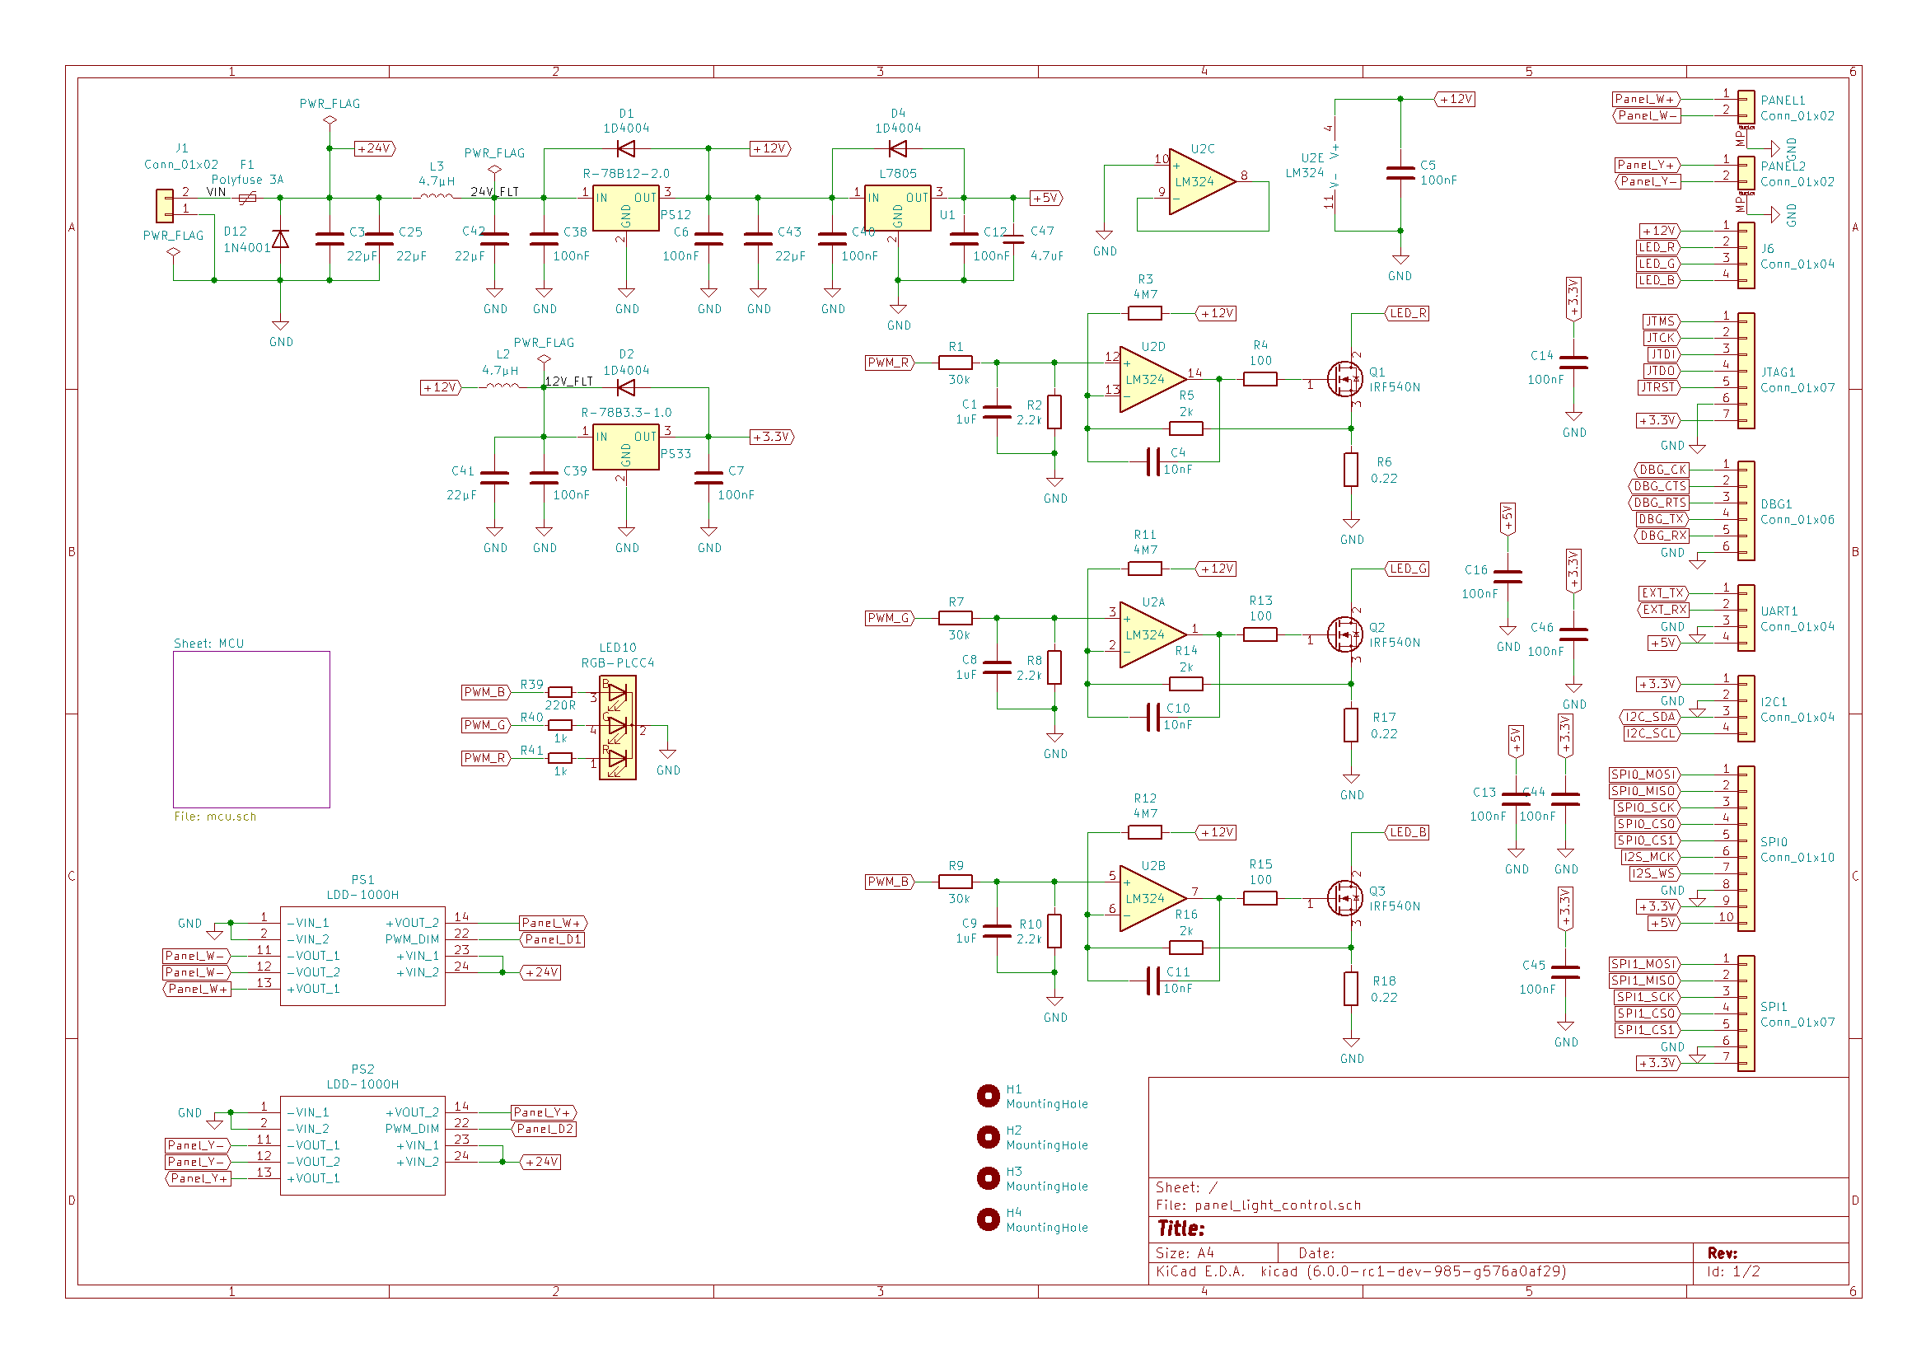
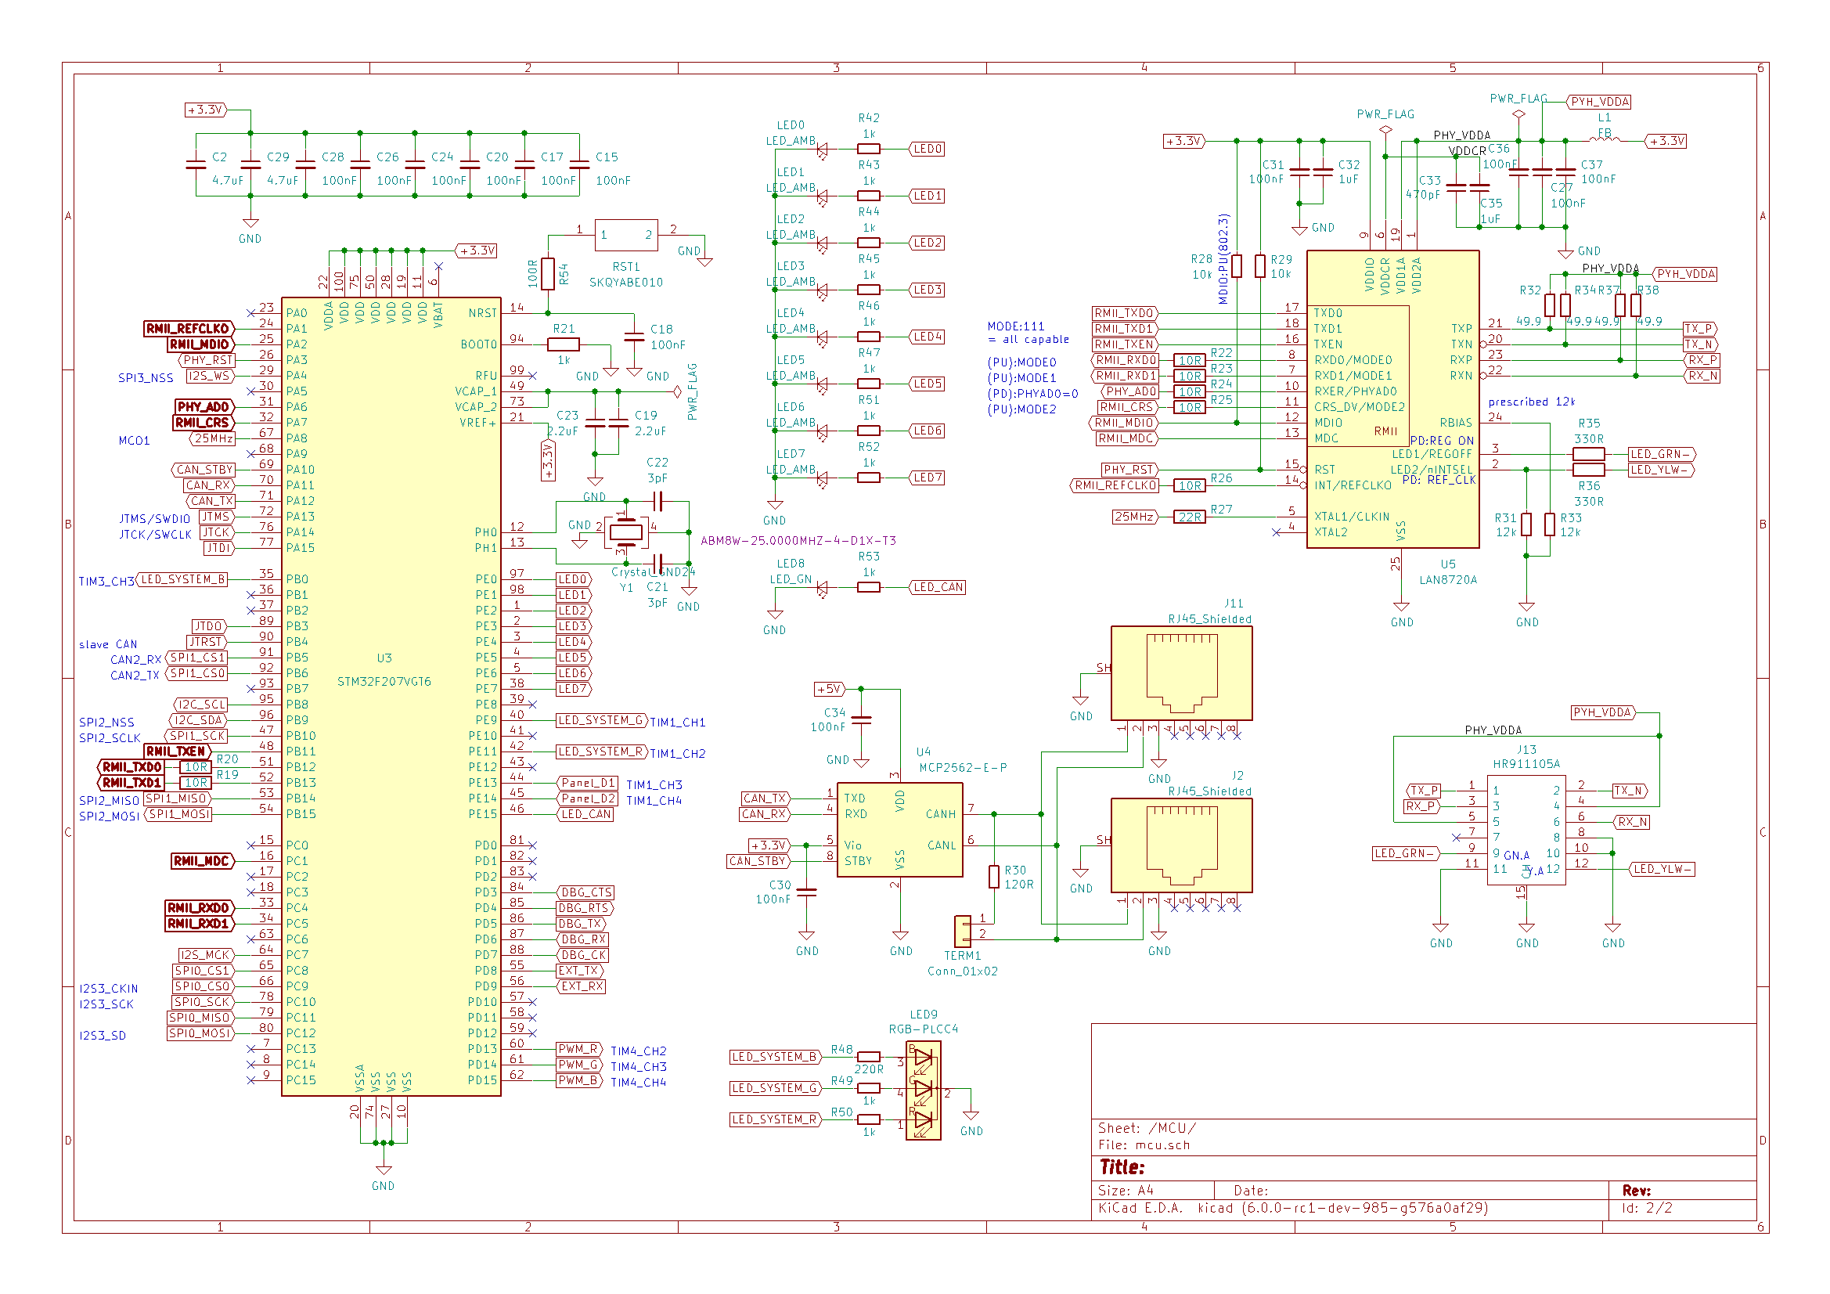
KiCAD schematics and board files as OSHW

Slide 8
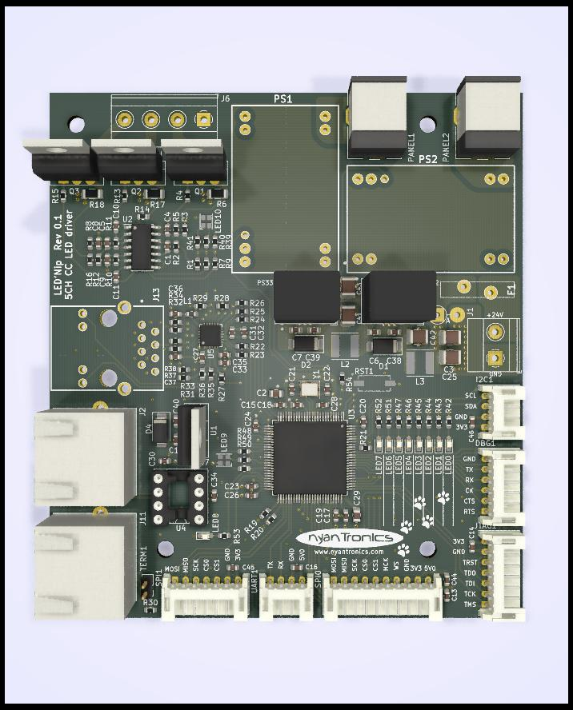
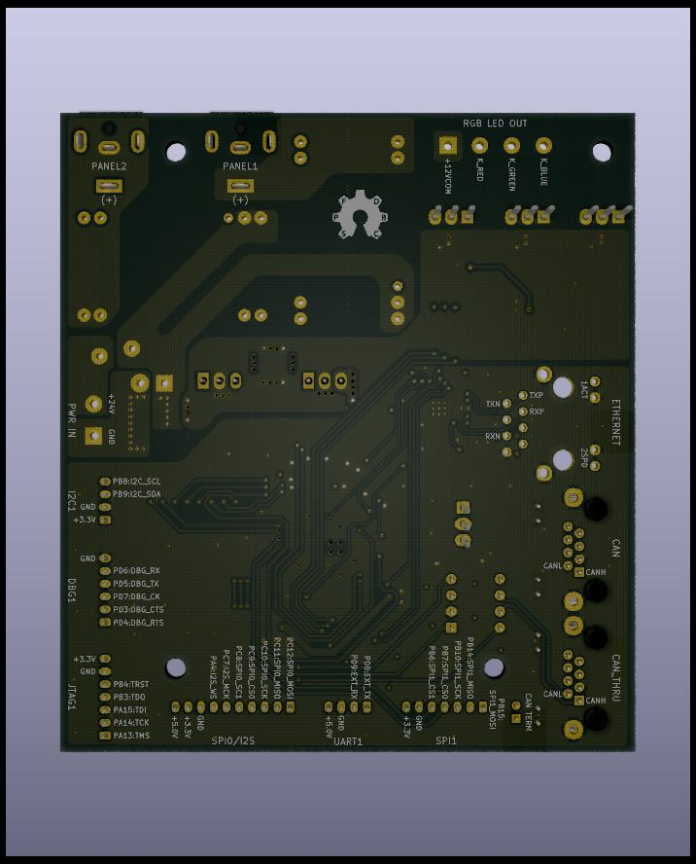
KiCAD schematics and board files as OSHW

